Slide 1
Plasmid sequencing policy and procedures for BMD KSQ
Updated 2024 January

Slide 2
Plasmid sequencing policy for BMD KSQ
ALL plasmid sequencing will be done in-house, with only a limited set of exceptions.
Colleagues are expected to use the in-house procedures outlined in this slide deck.
Colleagues are reminded to
Be responsible: provide the colleagues who are doing the sequencing work with advance notice and all the information they need.
Be flexible as in-house procedures are adjusted to workload & technology.
Library sequencing (e.g. bulk NGS of phage outputs or immune repertoires) is handled separately from the procedures discussed in this slide deck. Contact: Jon McDaniel

Slide 3
Starting in January 2024, all in-house sequencing requests will use new GDBxT system
Separate requests for full plasmid and amplicon sequencing
Submit request through GDBxT
Details of GDBxT request system here
While the system is in the early roll-out period (Jan-Feb 2024), please check with the appropriate contact person (Hamza Sahil, Ilya Tikh, HTP Nanopore team) to make sure that the correct information is in place.
Bioinformatics contacts:
Request system will notify appropriate bioinformatics scientist.
Users with questions about the data they receive should contact Lijian Yu for Nanopore, Tatyana Zamkovaya for PacBio

Slide 4
Procedures for BEP, RNA, TPS groups
Protein expression constructs (without polyA):
Contact: Hamza Sahil
Process: Full-plasmid sequencing Details here
RNA expression constructs with polyA:
For requests of >32 plasmids: PacBio. Contact: Ilya Tikh Details here
For requests of <32 plasmids:
Full-plasmid sequencing (Contact: Hamza Sahil Details here )
PolyA check (Wyzer): single read, Sanger, raw data, no editing. Details here
No need to re-sequence vendor constructs that are already sequence-confirmed

Slide 5
Procedures for Antibody Discovery/Engineering groups
Antibody discovery sequencing (e.g. panels from phage, immune sources)
Contact: HTP nanopore team (Shayne Sherry, Joe Bedard, Oliver Ho, Lauren Krause)
Process: Amplicon sequencing Details here
Protein engineering sequencing (e.g. in-house cloned constructs)
Protein expression constructs:
Contact: Hamza Sahil
Process: Full-plasmid sequencing Details here
RNA expression constructs encoding polyA
For requests of >32 plasmids: PacBio. Contact: Ilya Tikh Details here
For requests of <32 plasmids:
Full-plasmid sequencing (Contact: Hamza Sahil Details here )
PolyA check (Wyzer): single read, Sanger, raw data, no editing. Details here
No need to re-sequence vendor constructs that are already sequence-confirmed

Slide 6
Procedures for HTP
Protein expression constructs (without polyA):
Contact: HTP Nanopore team (Shayne Sherry, Joe Bedard, Oliver Ho, Lauren Krause)
Process: Amplicon sequencing Details here
RNA expression constructs encoding polyA
For requests of >32 plasmids: PacBio. Contact: Ilya Tikh Details here
For requests of <32 plasmids:
Full-plasmid sequencing (Contact: Hamza Sahil Details here )
PolyA check (Wyzer): single read, Sanger, raw data, no editing. Details here
No need to re-sequence vendor constructs that are already sequence-confirmed

Slide 7
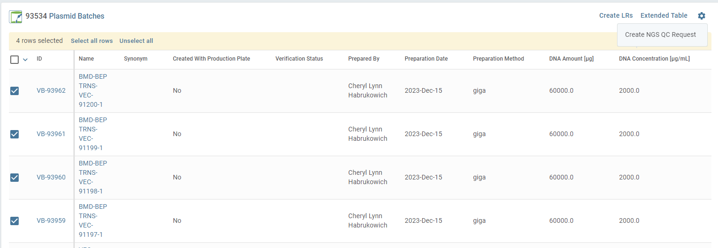
How to use GDBxT request system – Plasmid Sequencing 1
Make sure that there are Plasmid Batches (VBs) for each plasmid you want sequenced
If not you can create them in Genedata either through the VEC page for your plasmid or by bulk upload
Be sure to enter a concentration for the VB and set the status to ‘Prepped’
From a table of VB’s (e.g. the Plasmid Batch Compendium) select the samples of interest and choose ‘Create NGS QC Request’

Slide 8
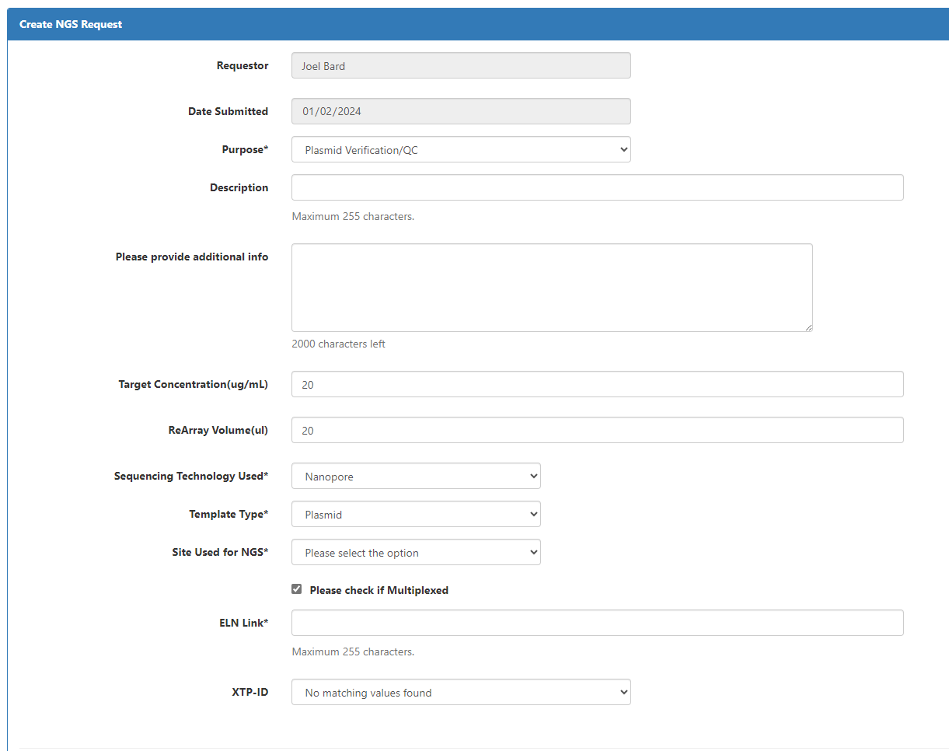
How to use GDBxT request system – Plasmid Sequencing 2
You will be taken to a new page in GDBxT
Nice to have
Nice to have
Default is Nanopore. Change to PacBio if needed.
Required. Choose the site where NGS is being done.
Optional. Paste Signals link. Could be ELN for design or for DNA prep. This will be revised…

Slide 9
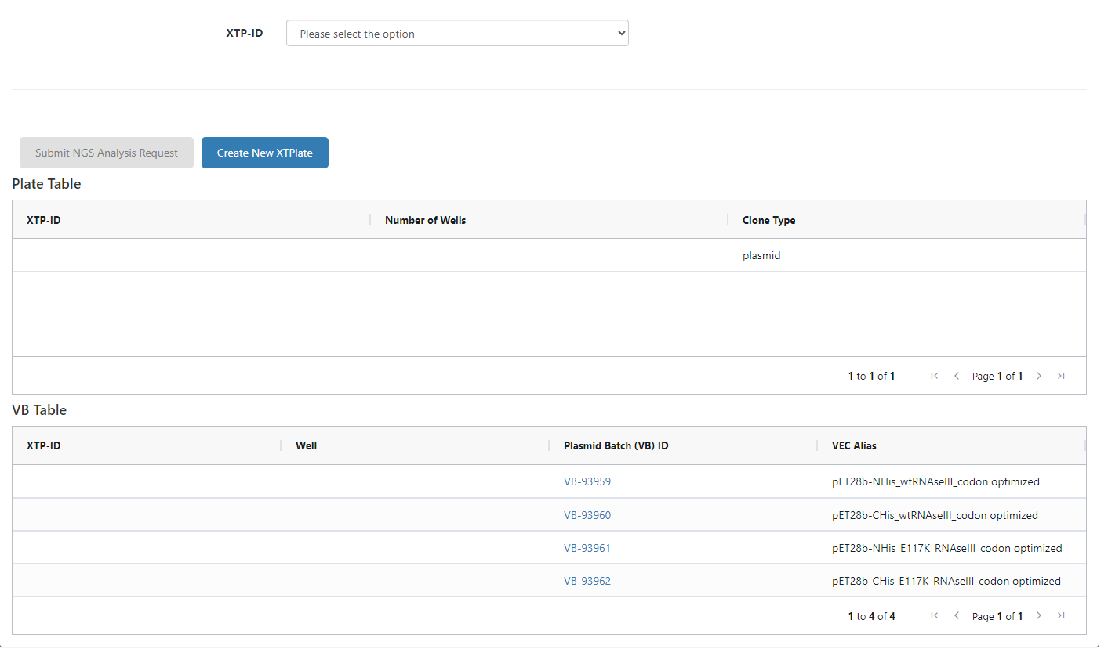
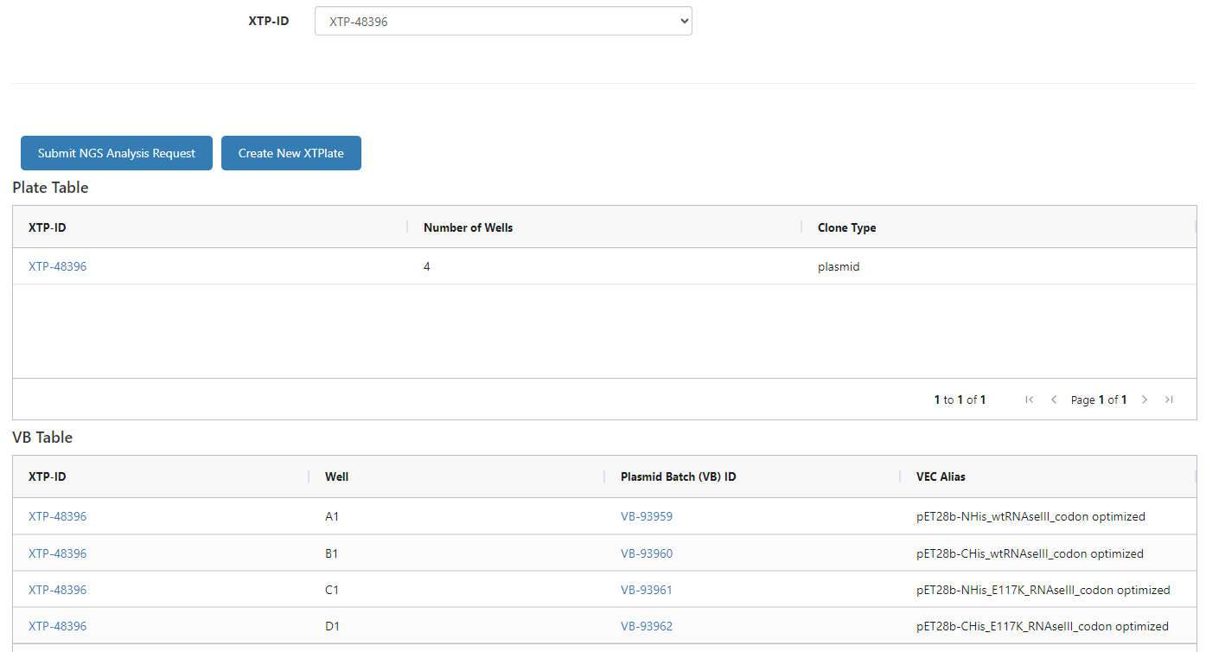
How to use GDBxT request system – Plasmid Sequencing 3
Samples must be submitted in a plate. Further down the request page is a table of the VBs that were included in the request. Click Create new XTPlate and a plate will be created in the database. Be sure to put the assigned sample in each well.
Click “Submit NGS Analysis Request”. Emails will be sent to the appropriate people.

Slide 10
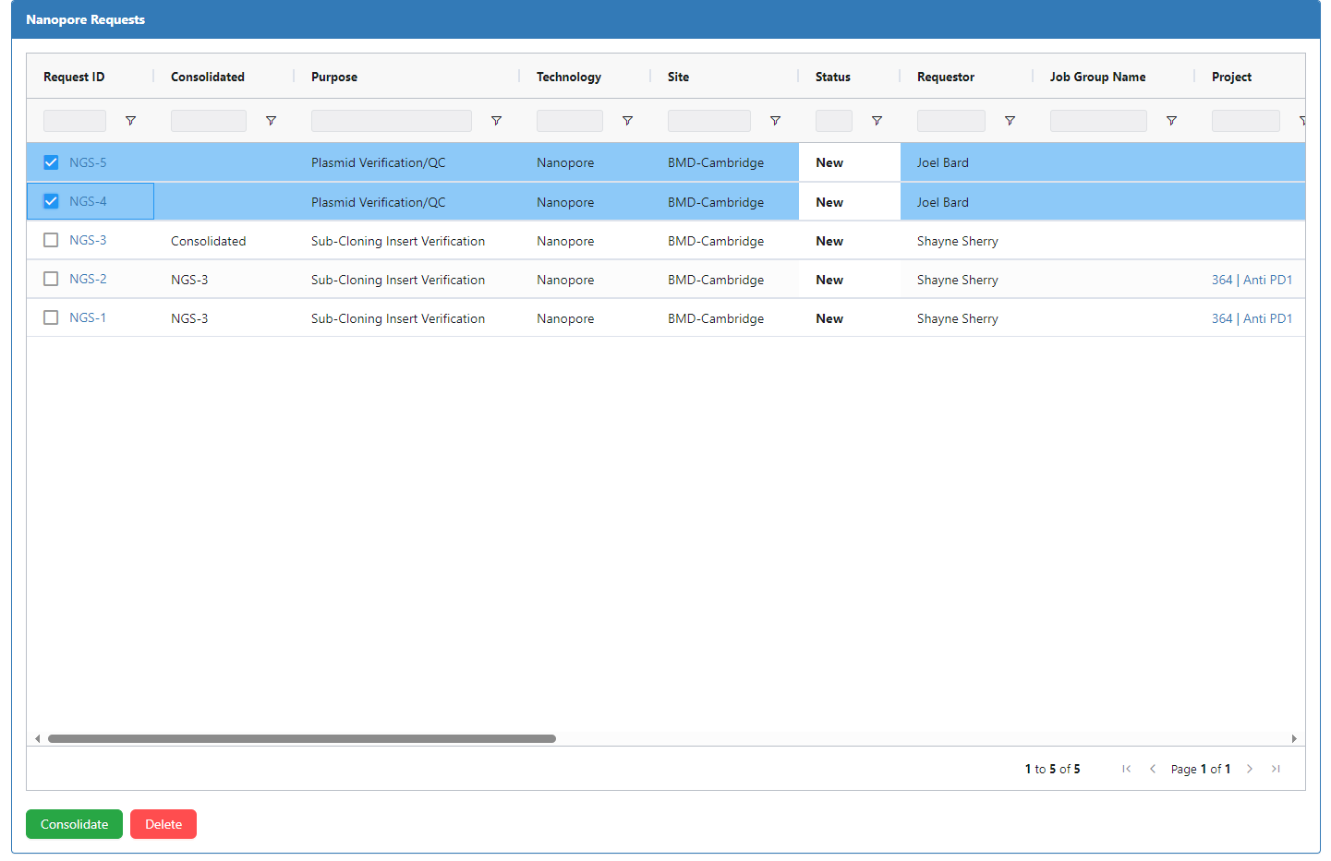
How to use GDBxT request system – Plasmid Sequencing 4
Once submitted, NGS requests can be viewed through the NGS Portal
Plasmid QC requests that will be run together can be consolidated from this page. This must be done by the person executing the request prior to running the samples.

Slide 11
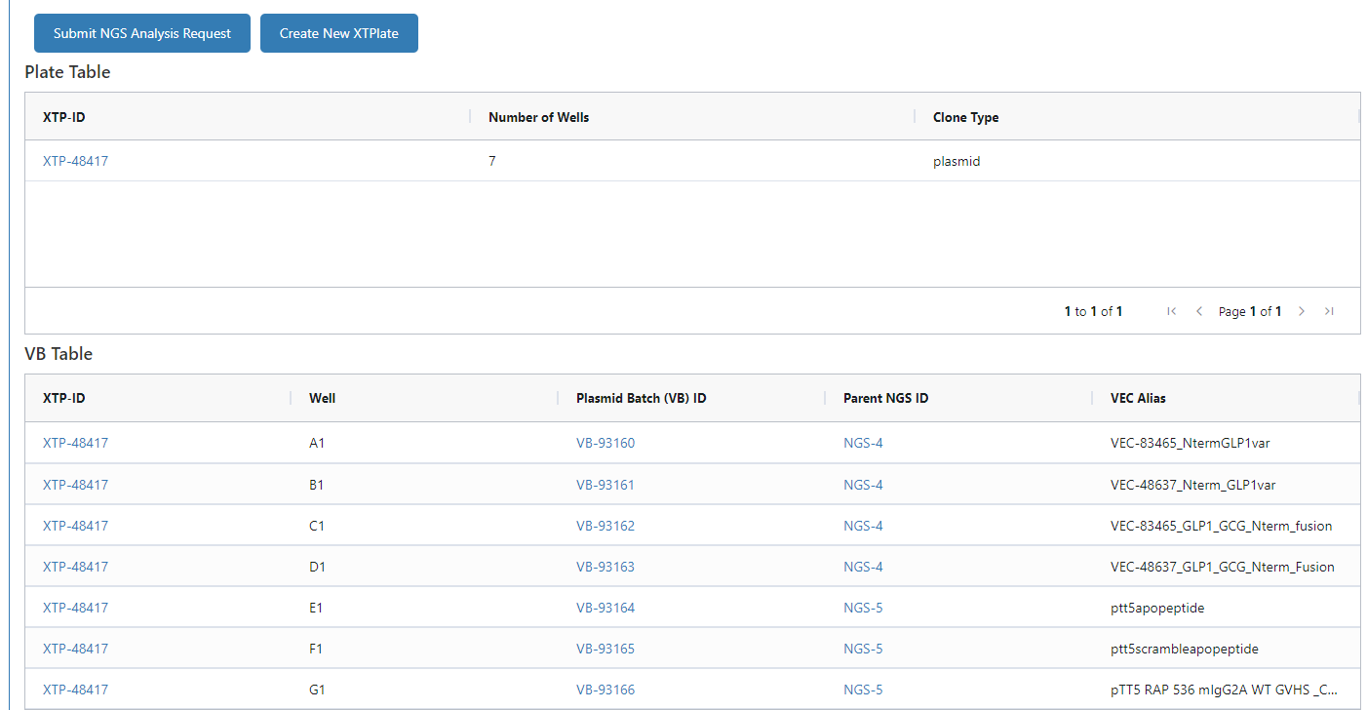
How to use GDBxT request system – Plasmid Sequencing 5
Consolidation will create a new NGS request where the person executing the run will create a new XtPlateSet which consolidates all the VBs from the parent NGS requests into a single plate for processing

Slide 12
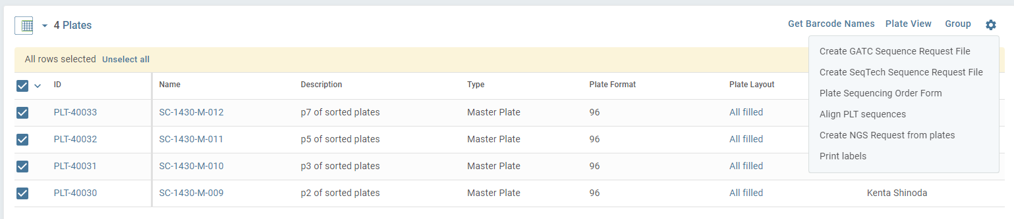
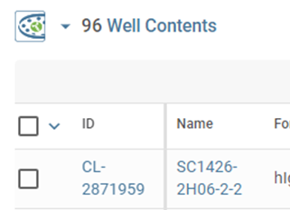
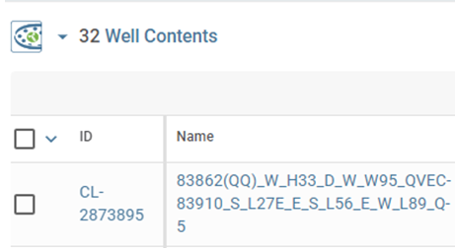
How to use GDBxT request system – Amplicon (Screening) Sequencing 1
This allows you to request sequencing from Genedata plates.
Go to the relevant PlateSet within your Screening Campaign.
Select the PLT IDs that you want included in your Nanopore run.
Click the Gear Icon and select “Create NGS Request from plates”
Caution: the names of the clones must currently begin with SC followed by 4 digits (SC1234) in order for software to parse sequences. This may change in the future.
good
Will not work

Slide 13
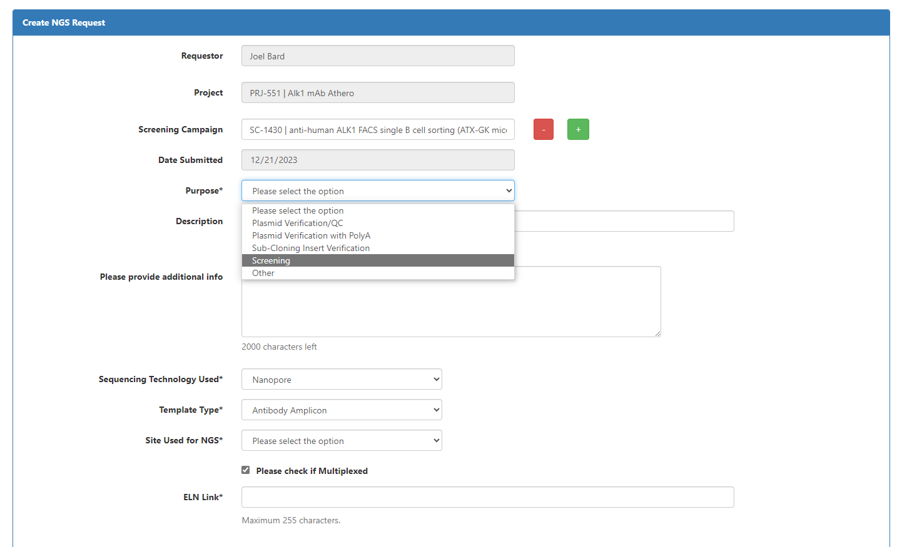
How to use GDBxT request system – Amplicon (Screening) Sequencing 2
You will be taken to a new page in GDBxT
Required
Nice to have
Nice to have
Required
Required. Any relevant Signals link.

Slide 14
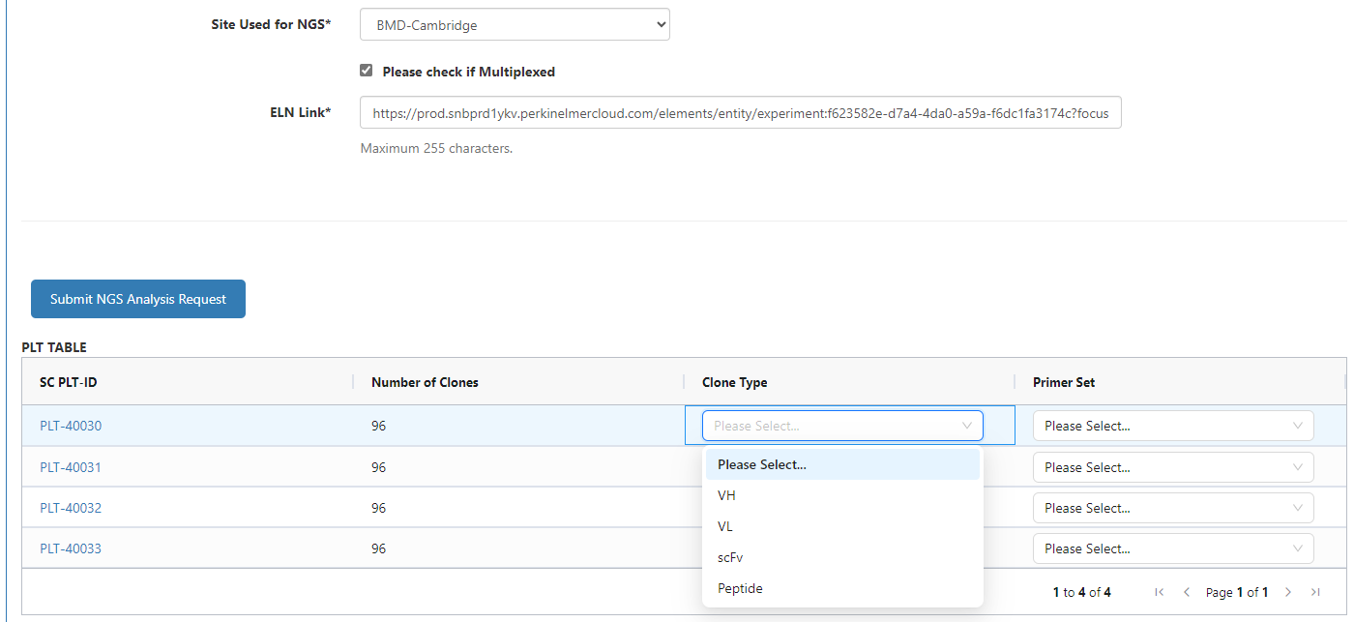
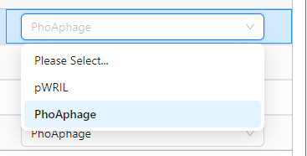
How to use GDBxT request system – Amplicon (Screening) Sequencing 3
For each plate set the Clone Type and Primer Set. Choice in the top row autofills down.
Note that if you’re sequencing VH and VL from the same PLT IDs (hybridoma workflow) you’ll have to create two NGS requests which will then be consolidated.
Click Submit and emails will be sent

Slide 15
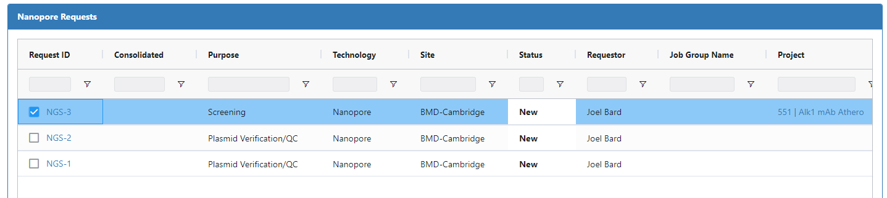
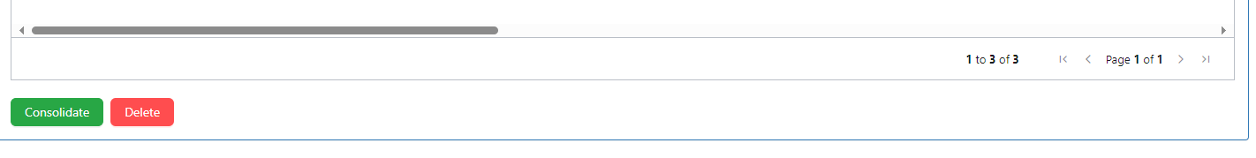
How to use GDBxT request system – Amplicon (Screening) Sequencing 4
This step to be used only by the person processing the samples (e.g. HTP Nanopore team members)
The full set of NGS requests can be viewed through the NGS Portal
If (and only if) you are doing the PCR you need to create a “Consolidated” request even if only running a single request. Check with Sara before doing this as there may be other requests that could be included in the same run.
Select 1 or more plates that will be included in the same Nanopore run and click Consolidate

Slide 16
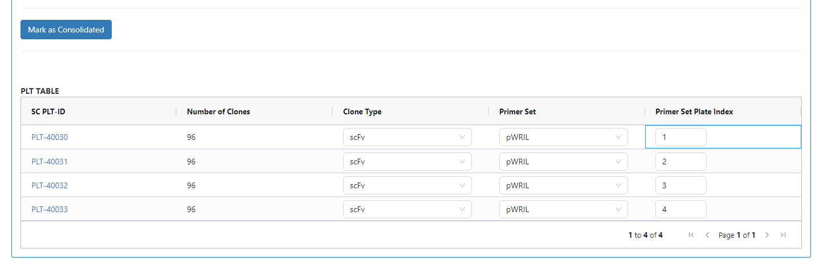
How to use GDBxT request system – Amplicon (Screening) Sequencing 5
This step to be used only by the person processing the samples (e.g. HTP Nanopore team members)
You will see a new NGS Request page.
The main point of this is to assign the reverse barcodes which distinguish the individual plates in the final results.
You can assign the plate indices at the bottom of the page.
Be sure to use the primer plates that correspond to the assigned Primer Set Plate Index for each PLT

Slide 17
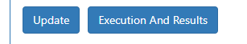
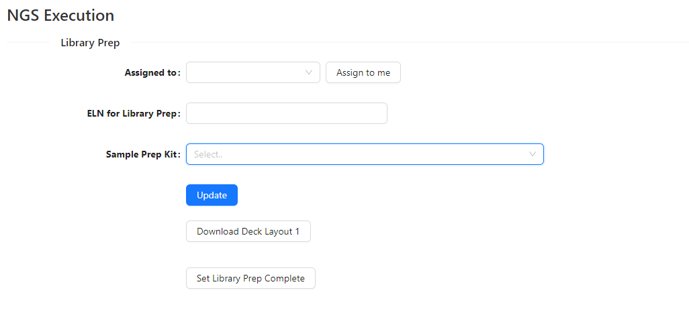
How to use GDBxT request system – Amplicon (Screening) Sequencing 6
This step to be used only by the person processing the samples (e.g. HTP Nanopore team members)
After Mark as Consolidated has been clicked new buttons will appear
If you click on Execution and Results you’ll be able to download a Deck Layout file indicating which plates should go in which position on the i7 for PCR setup

Slide 18
Primers for Nanopore Amplicon Sequencing
For amplicon sequencing, all primers need to be registered in the GDBxT database.
If you need to use primers that are not available in the database please discuss with Sara Hanscom and Joel Bard before starting your PCR.
The list of available primer sets can be found here. New primer sets must be submitted using the template (click the Download Template tsv button) from GDBxT.

Slide 19
Procedure for Plasmid Sequencing requests
Request Submission: Requestors must submit their requests using GDBxT by 10AM on Tuesdays and Thursdays.
Plasmid Sample Submission: Requestors must submit purified plasmid samples to USAX3-610N/004/429 in the DNA drop off fridge.
To be included in the NGS run for next-day results, samples need to be dropped off by 12PM on Tuesdays and Thursdays.
Plasmid submission details:
Reference Sequences: Confirm the correct reference sequences are uploaded to GeneData before sample drop-off.
Purification Methods: All purification methods are acceptable. If using a purification kit with a precipitation step, ensure that any residual alcohol is removed from the sample.
Concentration: Each sample MUST have a volume of 100uL and be normalized to 20 ng/uL.
Tube/Plate Format: Samples MUST be submitted in either 8-strip tubes or a 96-well plate, arranged column-wise starting from position A1.
Sample Naming: Each sample MUST have the VB-ID as the sample name.
In the rare situation that additional capacity is needed, Hamza will coordinate use of Wyzer Plasmid Simple sequencing for full plasmids

Slide 20
Procedure for Amplicon Sequencing requests
Deadlines may change. Please connect with Shayne, Joe, Oliver, and Lauren as early as possible.
Contacts: HTP nanopore sequencing team (Shayne Sherry, Joe Bedard, Oliver Ho, Lauren Krause).
Individuals from discovery groups may also be trained as superusers.
For phage library clones:
Requestor prepares 100 ul of 1:10 dilution of glycerol stocks in water.
Requestor submits request in GDBxT (using PLT numbers) and provides diluted glycerol samples to HTP by 12PM Tuesdays and Thursdays.
HTP completes plate consolidation in GDBxT, runs PCR and Nanopore prep.
For pTT5/other vector clones made in HTP:
Requestor submits request in GDBxT (using PLT numbers) by 12PM Tuesdays and Thursdays.
Templates are 1:10 glycerol stock dilutions

Slide 21
Procedure for PacBio requests
Please contact Ilya at least 1 week prior to expected run date, since PacBio is not run on a regular schedule
Requestor submits request in GDBxT
Requestor submits purified plasmid samples to Ilya the day before the sequencing run. Data is usually available in 3-5 business days after sample receipt
Plasmid submission details:
Acceptable purification methods: Miniprep, >20ul of sample
Concentration: 30-100ng/ul, standardized across the plate
Tube/plate format: 96-well preferred, 8-well strips also ok
Sample naming: All samples must have VBs registered in GD

Slide 22
Procedure for Wyzer requests
ONLY the following request type from Wyzer is permitted under the current budget. This is focused on sequencing just the polyA region of RNA vectors
Questions on approved uses of Wyzer sequencing should go to May Tam.
Order online via Wyzer website
Create Sanger Order →Result type →Raw Data
This does NOT include editing or double-stranded reads. Users are expected to address questions on their own by inspection of chromatograms supplied by Wyzer.
User submits DNA at 100-200 ng/µL. Most commercial kits should be OK; avoid residual EtOH or salt (some care may be needed w. BioTage prep; consult Hamza, other Nanopore users in TPS,BEP)
Primer design for specific plasmids should read through polyA in single reads. Wyzer has designed primers. Consult Lisa Racie, Nathanael Lintner, Ilya Tikh for details on preferred primers.
S1 2024: users should identify primers that are working well for standard BMD vectors and update this slide deck.
VEC _____: Primer name _______ Primer sequence______ Note: reads from 3’ vector sequence through polyA
Note: There is a $15.00 per order charge (per primer, not per reaction) for design/handling/storing custom primers at Wyzer.
Raw reads should be charged $6 per reaction in addition to this per-order charge.
Please review Wyzer guidelines for sample preparation and submission

